Slide 1

INDOOR NAVIGATION SYSYEM
ENHANCING NAVIGATION WITHIN LAGRE INFRASTRUCTURES

Slide 2

THE CHALLENGE OF INDOOR NAVIGATON -
Large and unfamiliar buildings can be confusing to navigate.
Traditional signboards are outdated and often unclear.
Visitors waste time finding specific rooms or departments.
Examples:Hospitals: Relatives searching for a patient’s ward.Colleges: New students finding classrooms.Government buildings: Citizens locating departments.

Slide 3
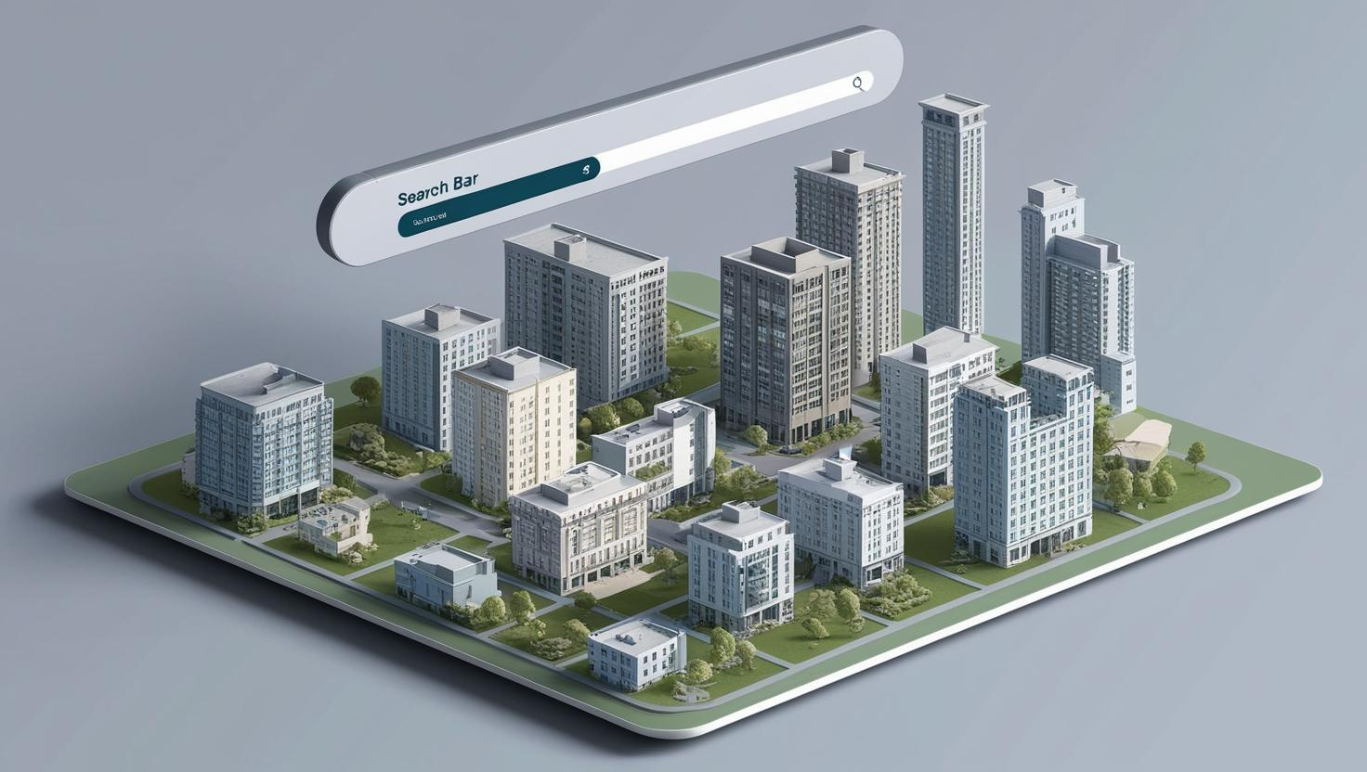
A web-based platform with a 3D map and search bar.
Provides directions and route maps to specific rooms or locations.
Uses QR codes and touchscreen kiosks for accessibility.

Slide 4
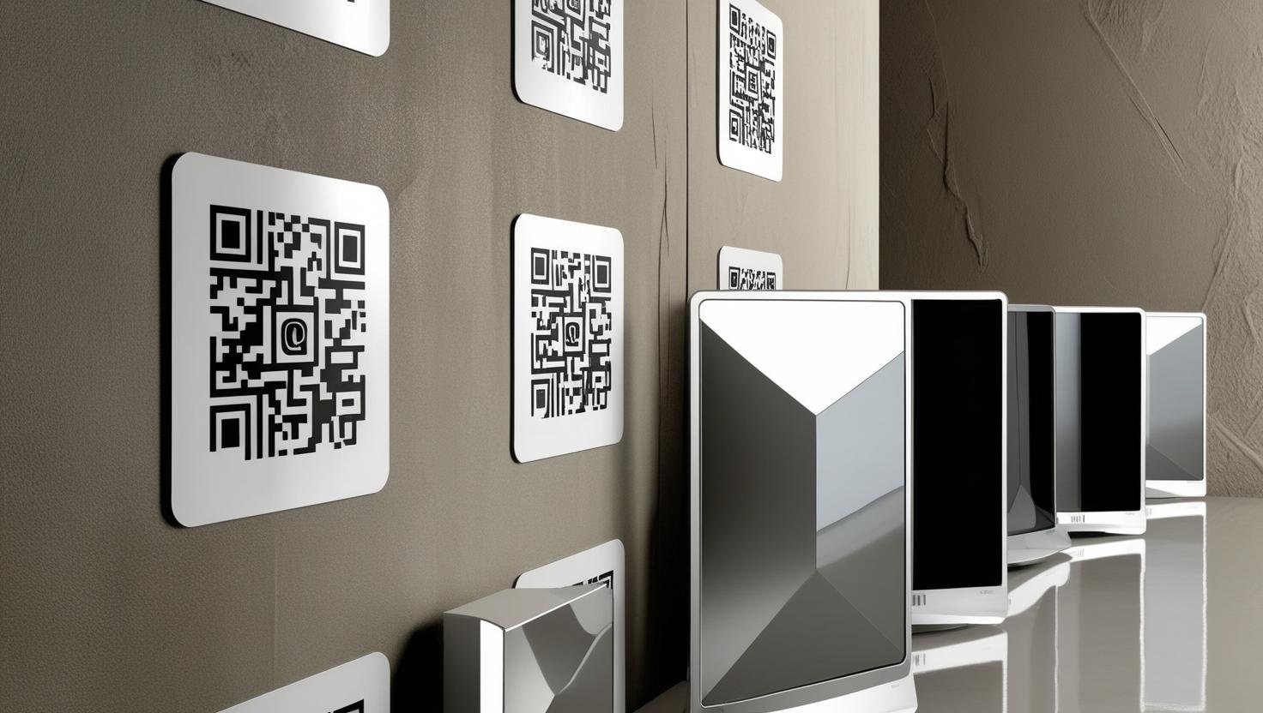
What Makes It Unique?
3D Maps: Interactive and easy-to-use interface.
Search Functionality: Quickly find rooms, departments, or facilities.
QR Code Integration: Scan and access the navigation system instantly.
Touchscreen Kiosks: Available in phone-restricted areas.
Real-Time Updates: Reflects live changes in room or department status.
Accessibility: Multi-language support and voice guidance.

Slide 5

Where Can It Be Used?
Hospitals: Locate wards, doctors, or departments.
Colleges: Navigate classrooms, labs, or auditoriums.
Government Buildings: Find specific offices or counters.
Malls: Locate shops, food courts, or restrooms.
Airports: Navigate terminals, gates, or baggage areas .
Resedential buildings:for finding specific flats and residence.

Slide 6
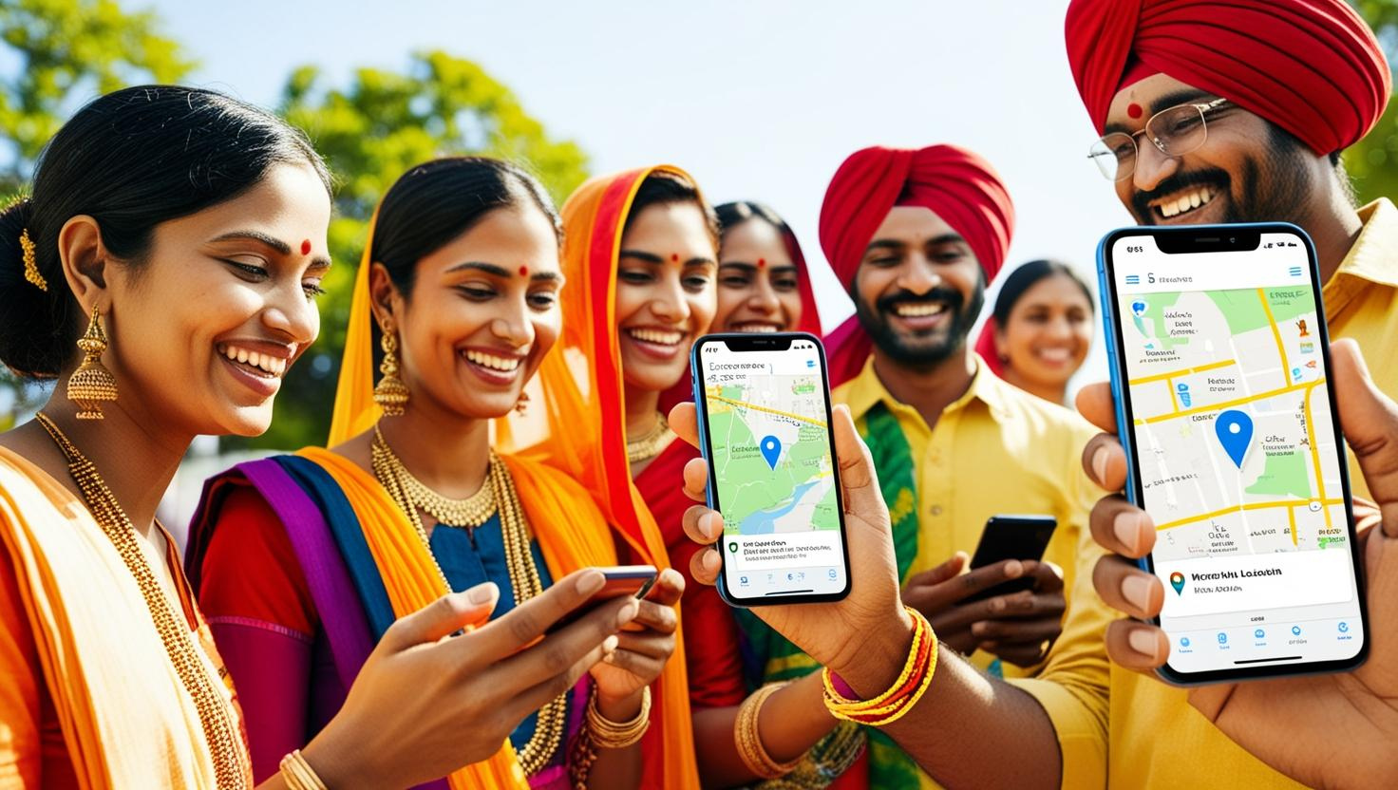
Why Choose Our System?
Saves Time: Quickly find the desired location.
Enhances User Experience: Modern and intuitive design.Reduces
Confusion: Clear directions and real-time updates.
Inclusive: Accessible for differently-abled individuals.

Slide 7
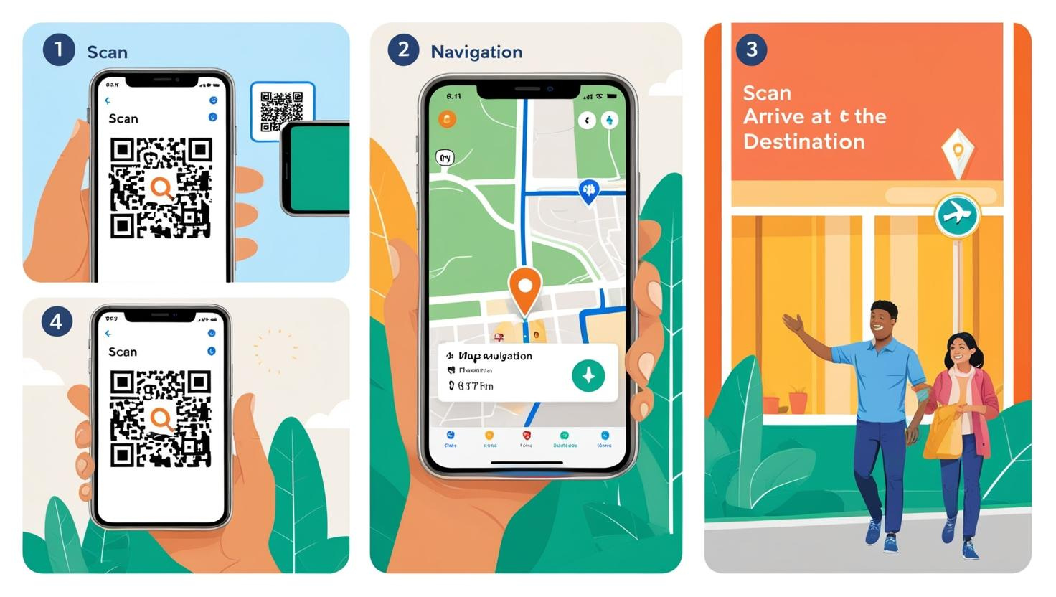
How It Works – Example in a Hospital
A visitor enters the hospital and scans a QR code at the entrance.
The system opens on their phone, showing a 3D map.
They search for "Cardiology Department" and get step-by-step directions.
Alternatively, they use a touchscreen kiosk for the same process.

Slide 8
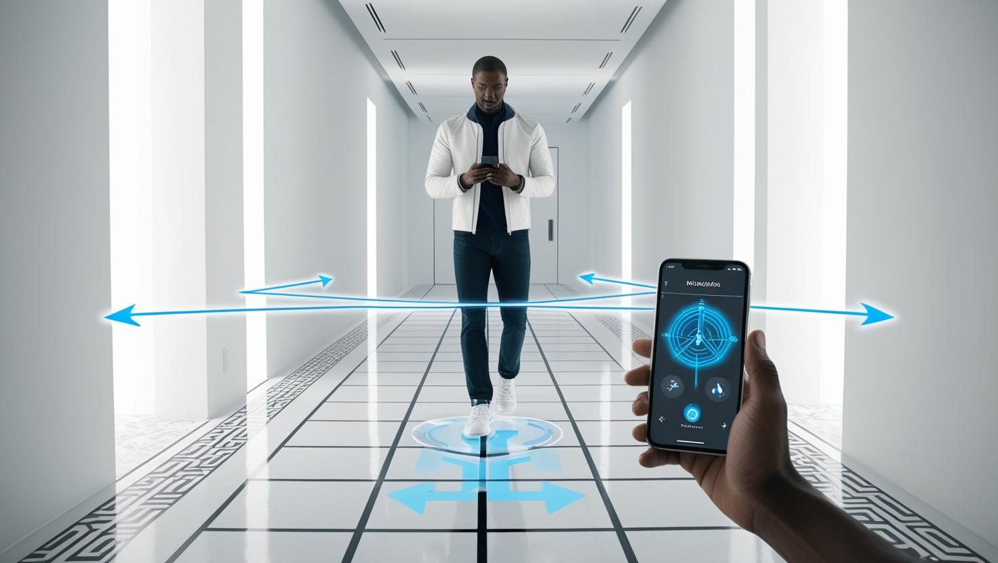
Transforming Indoor Navigation
The Indoor Navigation System simplifies navigation in large buildings.
It saves time, enhances user experience, and provides modern solutions.
Versatile, scalable, and future-ready for various applications.
Call to Action: Let’s revolutionize indoor navigation together!

Slide 9
Smart Autonomous Electric Shuttle for Large Spaces
Compact electric vehicle (golf cart-sized)
Fully autonomous – No driver required
Touchscreen interface – Users select their destination
Moves within fixed paths in large infrastructures
Traditional large spaces require long walking distances
Many visitors struggle with navigation & accessibility
Our solution: A self-driving electric shuttle that moves like an elevator but horizontally

Slide 10
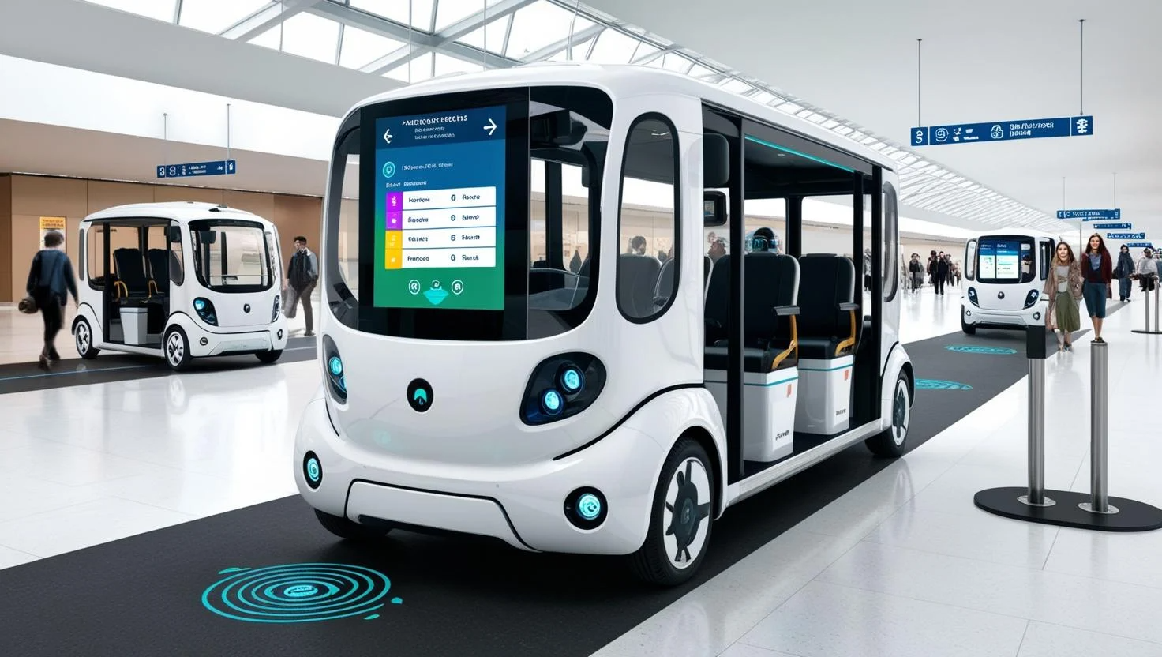

Slide 11
TECHNOLOGIES USED:
HTML5 – Structure of the web pages.
CSS3 (Tailwind CSS) – Styling and layout for a modern, responsive design.
JavaScript (Vanilla JS) – Handles user interactions and logic for navigation

Slide 12

Any queries and suggestions--

Slide 13

DONE BY :
V SANTHOSH – 23HP1A4461
CH SIDDHARDHA – 23HP1A4462
BALA PRASANNA - 23HP1A4447
BALA ARUNKUMAR - 23HP1A4446

